Slide 1
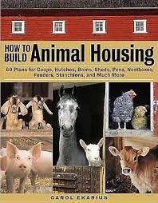
Animal Housing
By
Dr.Magareb.m

Slide 2
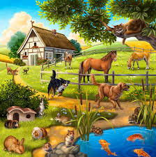
Animal housing
They are areas where animals seek shelter to protect themselves from the effects of changing weather such from heat in the summer, cold and rain in the winter, to keep them safe from insects and dangerous animals, and to provide a comfortable environment for them, especially after they return from grazing or work, to make their care and feeding easier..
Most farm animals require some form of protection from the elements. Most people believe that the most crucial time to give shelter is during the winter, however an animal's natural coat allows them to withstand far colder temperatures than humans. Summer heat is significantly more difficult on animals than winter heat if they do not have access to shade, whether from trees or structures on grassland, or from a lack of ventilation in a barn or building

Slide 3
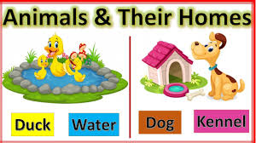
When constructing a building, there are a few things to consider.
1-The animal's physiological traits, as well as the extent to which meteorological elements influence the animal's nature, health, andproductivity
2-Improving sanitary conditions so that when creating structures, the ease of fighting infections and avoiding their spread is considered, as well as the convenience of cleaning and disinfecting them

Slide 4
production strategy
Identifying the project's goal, the type of animal production, the invested capital, project requirements, building materials, and other tools
Site selection
1-It should be near a shopping center or major city, but not near residential areas.
2-To limit disease transmission between farms, the distance between farms should be two kilometers.
3-Being close to major roads will make it easier to get supplies to the farm.
4-Being close to food and livestock markets
5-It should be kept dry and well ventilated

Slide 5
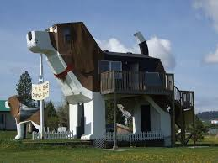
a building design
When designing structures, simplicity and low cost are considered, as well as several factors that must be considered
1-kind of animal
2-animals' numbers
3-define the design style (open or close)
4-the amount of space required for all animals
5-building directions.
6-close to farmland

Slide 6
Construction
1-A concrete floor that is deeper and thicker than the width of the wall on which it is erected is required when constructing buildings.
2-To keep moisture out of the foundation, one centimeter of asphalt is applied.
3-After constructing brick or limestone walls to improve warmth in the winter and cooling in the summer, the thickness of the wall must not be less than (33 cm) and the height must not exceed three and a half meters to ensure ventilation
Cement must be applied to the inside as well as the outside of the walls 4-.
5-Walls can be paved with faience or painted to be smooth and easy to clean from the inside at a height of (2-1.5 m), while the rest of the wall is painted with lime and dusted with cement from the outside.
6-The walls must be kept dry at all times since moisture encourages bacteria and fungi to thrive in the housing, resulting in an offensive odor

Slide 7
Roofing
Roof
Red tiles
Concrete
Wood (sheep)
Open
Central
Roof
Close
On Side

Slide 8
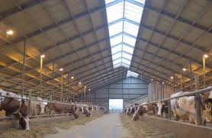
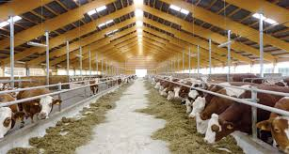
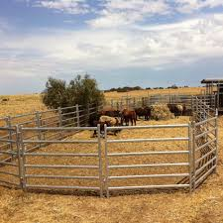

Slide 9
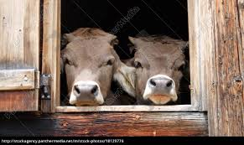
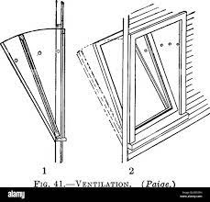
Windows
1-Windows provide ventilation and lighting in a home, and their area should not be less than (1:20-15:1) of the total floor space to suit both needs.
2-Height (2.5-2) meters above the ground level of the dwelling to protect the animal from air currents
3-It must open inward and have joints on the bottom (Sheringham system)
4-Air currents should not arise if they are placed opposite each other.
5-It must be covered with a net to keep flies and other hazardous insects out of the house, particularly the milking area

Slide 10
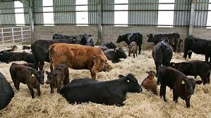
Flooring
1-The floor must be durable, wear-resistant, and long-lasting.
It's dry, impervious, and has the quality of not seeping water into the building 2-.
3-It should not be smooth to prevent the animals from slipping. The floor could be dirt, sand, or cement.

Slide 11
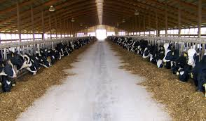
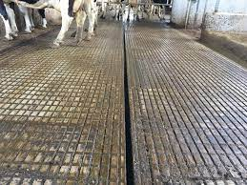
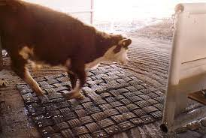
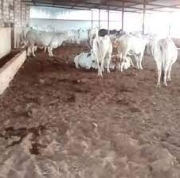
dirt floor
the groundIt is used to store manure beneath the animal, where it is covered with a layer of earth and so on whenever it gets wet until it rises to the surface, at which point it is carried to the fields for fertilizer.
Cement floor
This floor is made of cement and is inclined by 1% towards the back of the animal, where a gutter canal transports urine and washing water out of the builing. A rough surface is covered with a straw substance that is 15-30 cm high.

Slide 12
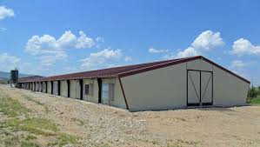
Doors
Barn doors must be wide, ranging from (2-2.5) m, open outward or by sliding, and not have sharp protrusions that could injure animals if they come into touch or clash with them when entering or exiting. The base of the doors must also be robust.

Slide 13
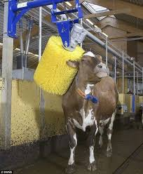
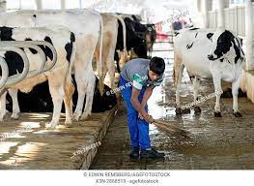
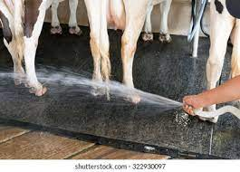
a requirement for animal protection
1-Avoid direct contact with animals to prevent the spread of respiratory infections.
2-Disinfection of the premises with disinfectants
3-Isolation of suspected animals in the southern half of the field
4-excellent ventilation
5-Regular cleaning of the premises and disposal of manure and garbage in appropriate areas

